Slide 1

Developing an appointment Chatbot for students
Final project presentation
Group 2: Yousef Almutairi, Devna Chaturvedi, Gireesh Kumar Muppalla, Sai Harshavardhan

Slide 2
CONTENT
Introduction
Related Work
Proposed Work
Implementation and Evaluation
Evaluation and Results
Conclusion
References

Slide 3
INTRODUCTION
Chatbot is one of the fast and effective methods of communication on many websites. Where the chatbot will converse with consumers and respond to all incoming inquiries.
we are developing a Chatbot application for the University of Missouri Kansas City to verify the possibility of booking an appointment with an academic supervisor as well as the availability of the recreational activity slots at the university.
This application aims to help students and faculty to book their appropriate appointments.

Slide 4
RELATED WORK
Chatbots can be problem-solution bots or domain-precise bots mostly they are knowledge based. These can act as Virtual aides for Problem solving.
Most of the Chatbots are designed with Pattern matcher, Suitable algorithms.

Slide 5
PROPOSED WORK
The main purpose of the chatbot is to respond to student queries with out manpower.
The chatbot receives the query, which is an input by the student, analyses it and in turn responds to the user with an answer.

Slide 6
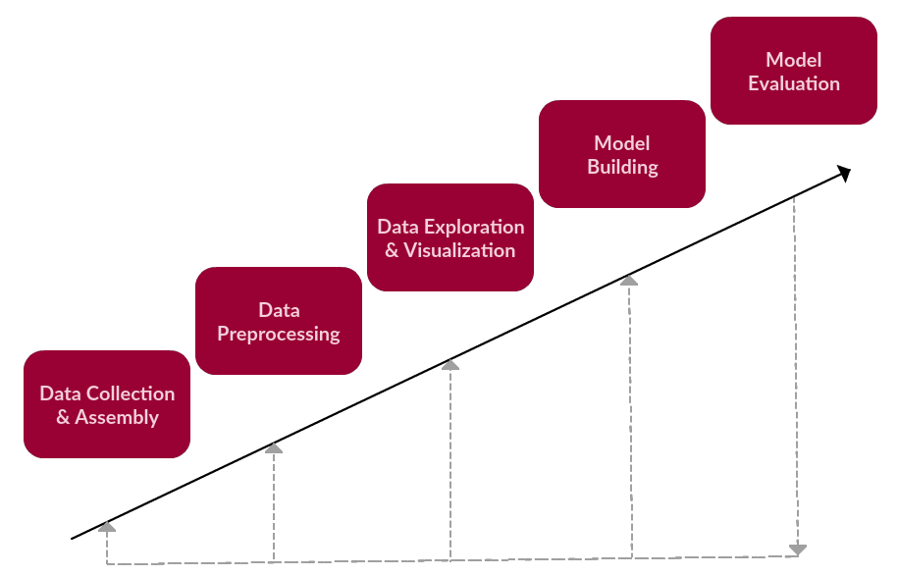
Implementation and Evaluation
Pre-processing using NLP
Splitting the data into train and test
Extracting the features on the train and test data
Selecting the algorithm
Naïve Bayes and Multinomial NB
Fitting the train data set with model

Slide 7

Flow of the system
Training Questions
Hi I can help you book a slot for recreational activities? 1
Corresponding Answers
1. Which time slot do you want to book and which activity?
Train
on vectors
Corresponding labels
In this case it is 1
Naïve Bayes Classifier
Word to be predicted
(in a vector form)
Recreational Activities

Slide 8
Working Algorithm
Step 1) Select a data set, for which we need to develop a chatbot.
Step 2) Prepare the set of entities with the patterns and the responses.
Step 3) Install the required packages in python
Step 4) Train the chatbot on the dataset to understand the intent of the user
Step 5) Develop the GUI and integrating it with the bot
Step 6) Execute the codes for the results

Slide 9

Methodology

Slide 10

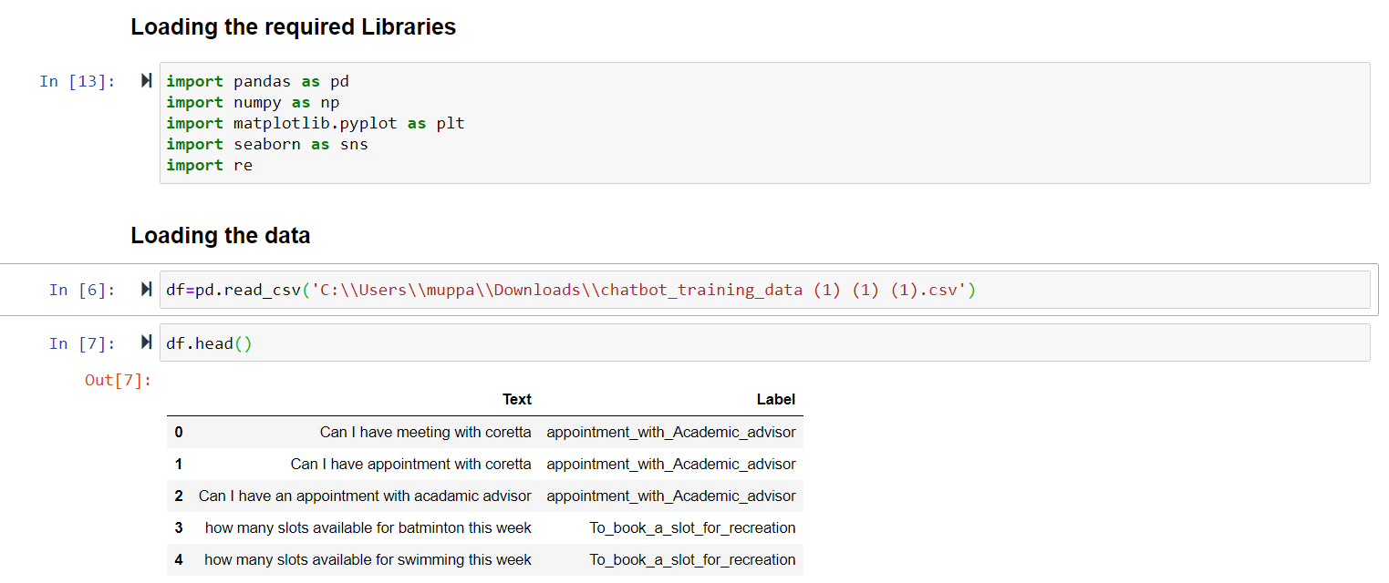
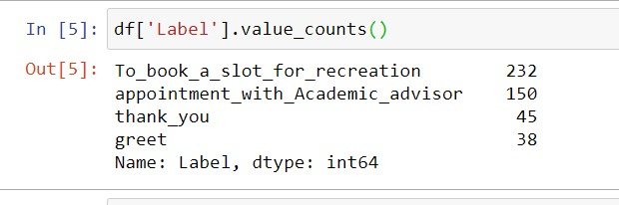
Pre-Processing using NLP
The analysis and pre-processing of the text is performed using NLP (Natural Language Processing) to clean the text and process it for further research by the model.

Slide 11
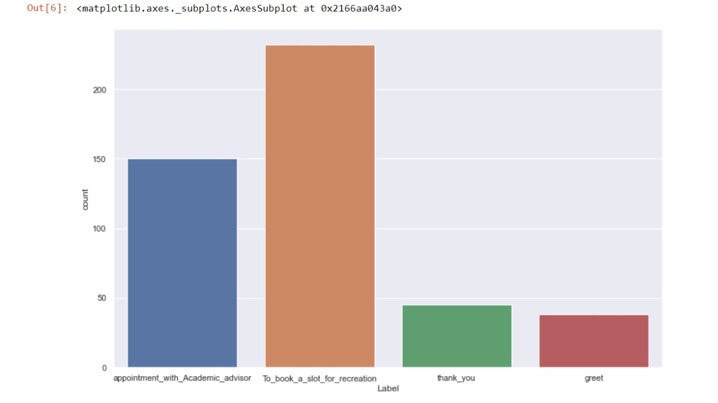
Class Distribution
Exploratory data analysis approach is used to analyse the datasets and the class distributions.
The results analysed below summarize the class distribution in the dataset.

Slide 12
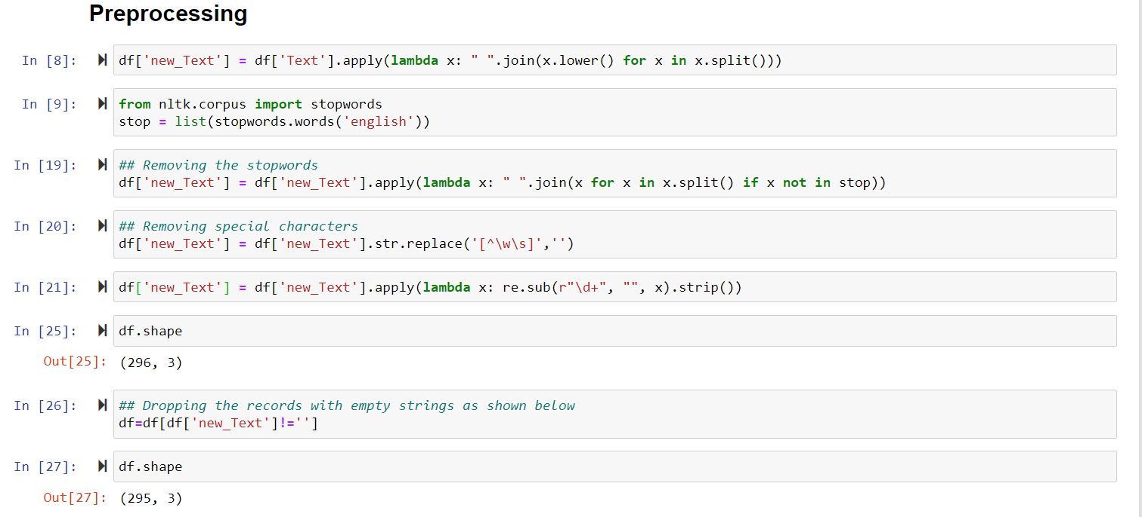
Pre-Processing the Text

Slide 13
Preparing the training data
The classes required for building the model are prepared in a file, along with a list containing question, labels and answers with the code below:

Slide 14
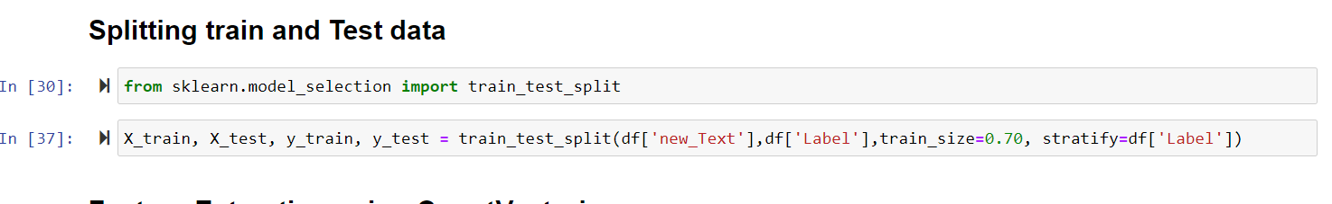
Splitting the data into train and test
The train-test split evaluation is executed to estimate the performance of the model using 70:30 ratio

Slide 15
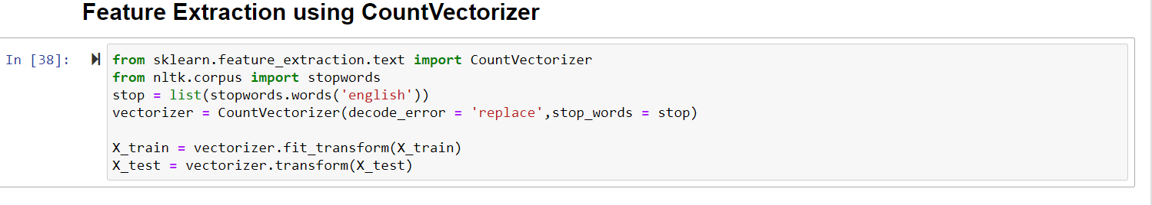
Feature Extraction using Count Vectorizer
We converted our training questions to vectors to feed them to the classifier.
The .fit_transform() method of CountVectorizer() does two things: 1) trains the features dictionary 2) Transforms each question into vectors of a size of features dictionary that contains zeros in all places except for the words used in the question

Slide 16
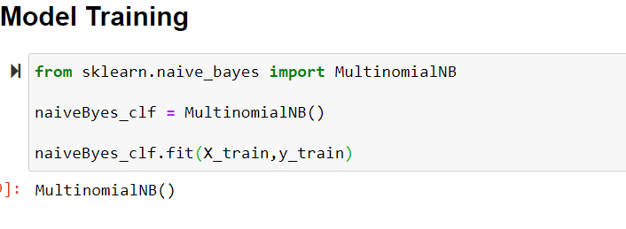
Multinomial Naïve Bayes
After creating the training vectors we created a Naïve Bayes Classifier.
We have used MultinomialNB() to train our classifier using .fit() method.
This trains the classifier to make the predictions by taking an input from the user , convert it into vector with the help of vectorizer and get predictions of the label

Slide 17
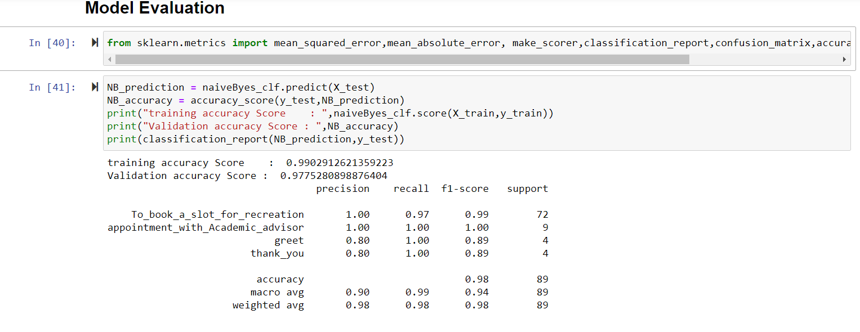
Evaluation and Results
The model evaluation is performed to check the accuracy of the trained model on the test dataset.
The accuracy achieved is 99.03 %. The classifier is able classify the intent of the user with 99% accuracy.

Slide 18
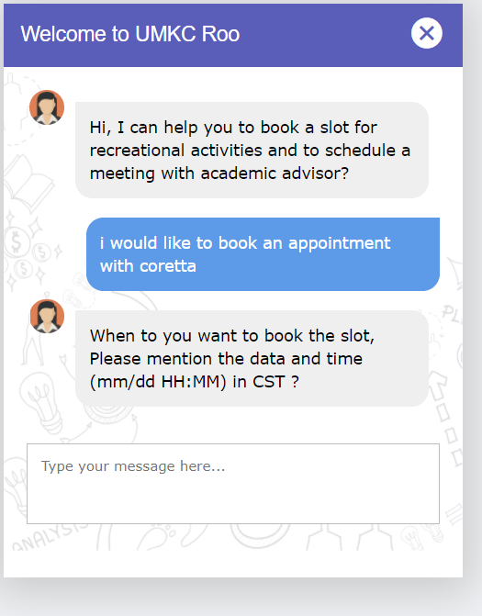
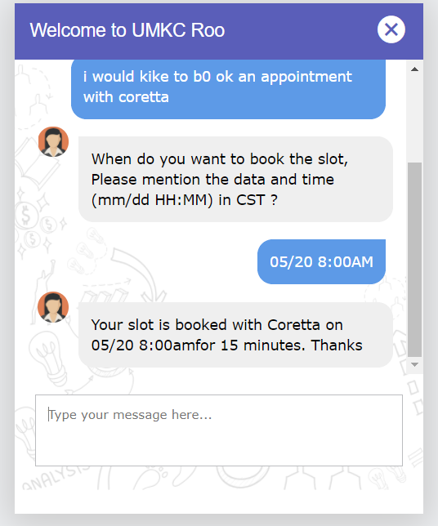
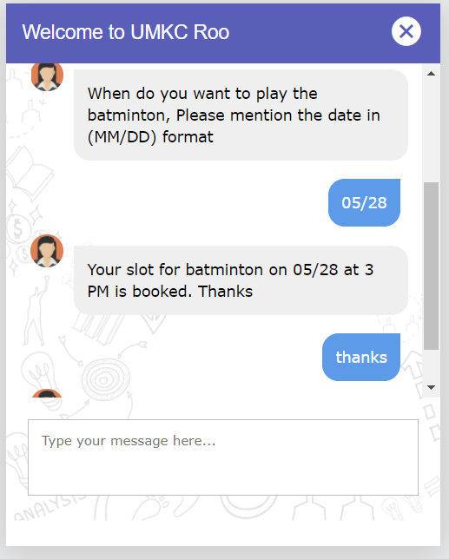
Evaluation and Results

Slide 19




Contributions
Created the input data for 2 classes
Created the script to log the conversations of chatbot
Designing the project
Loading the data
Preprocessing the data
Yousef
Gireesh
Created the input data for 2 classes
Database connections
Devna
Sai Harshvardhan
Created the UI
Programmed the flow
Build the model

Slide 20
Conclusion
It has multiple uses, and below, we explain the use case to show how helpful the appointment booking chatbot can be for the university
The chatbot processes that information and progressively gets better at answering the questions
The chatbot understands the intent of the user, it delivers the answer based on the existing data.

Slide 21
References
Colby, 1973 K. M. Colby. Simulation of Belief systems. In Schank and Colby (Eds.) Computer Models ofThought and Language, pp.251-286, 1973.
J. Clerk Maxwell, A Treatise on Electricity and Magnetism, 3rd ed., vol. 2. Oxford: Clarendon, 1892, pp.68–73.
I. S. Jacobs and C. P. Bean, “Fine particles, thin films and exchange anisotropy,” in Magnetism, vol. III, G. T. Rado and H. Suhl, Eds. New York: Academic, 1963, pp. 271–350.
K. Elissa, “Title of paper if known,” unpublished.
R. Nicole, “Title of paper with only first word capitalized,” J. Name Stand. Abbrev., in press.
Y. Yorozu, M. Hirano, K. Oka, and Y. Tagawa, “Electron spectroscopy studies on magneto-optical media and plastic substrate interface,” IEEE Transl. J. Magn. Japan, vol. 2, pp. 740–741, August 1987 [Digests 9th Annual Conf. Magnetics Japan, p. 301, 1982].
M. Young, The Technical Writer’s Handbook. Mill Valley, CA: University Science, 1989.

Slide 22

Q&A

Slide 23
Thank you

